Slide 1
Software Design
Assignment 2
Martín Díaz / Iñaki Errázuriz

Slide 2
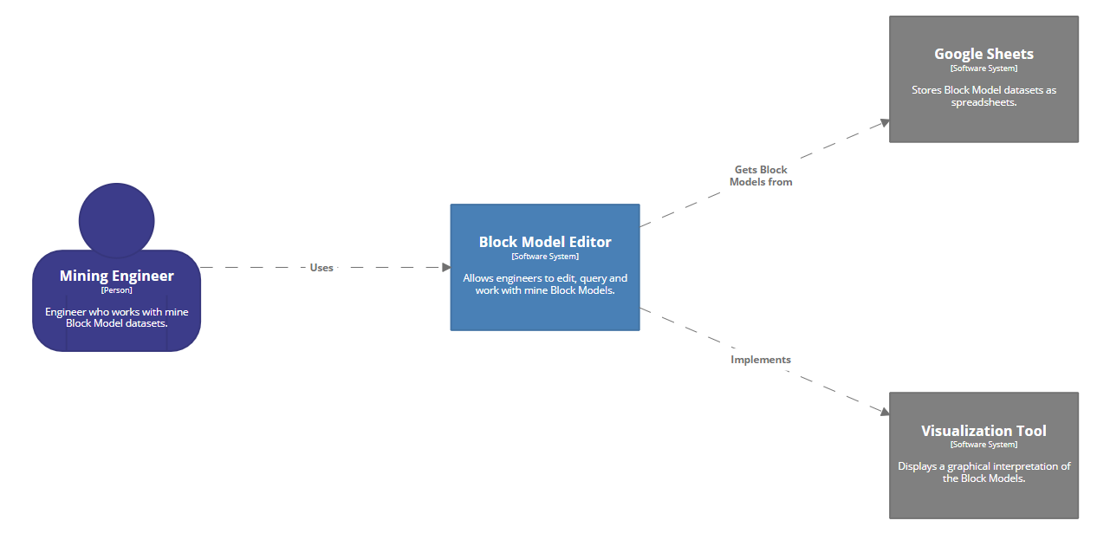
System Context Diagram

Slide 3


Technology Stacks
Python
Ruby on Rails + JavaScript

Slide 4
Pros
Python
More familiarized, easier to use.
Google sheets API compatibility
Ruby on Rails + JavaScript
Allows user to access through browser.
Clean GUI’s.
Google sheets API compatibility

Slide 5
Cons
Python
Not very friendly with GUI’s.
Dependent on local installation.
Ruby on Rails + JavaScript
The system becomes more complex (both Ruby and JavaScript).
Dependent on browser and internet connection.

Slide 6
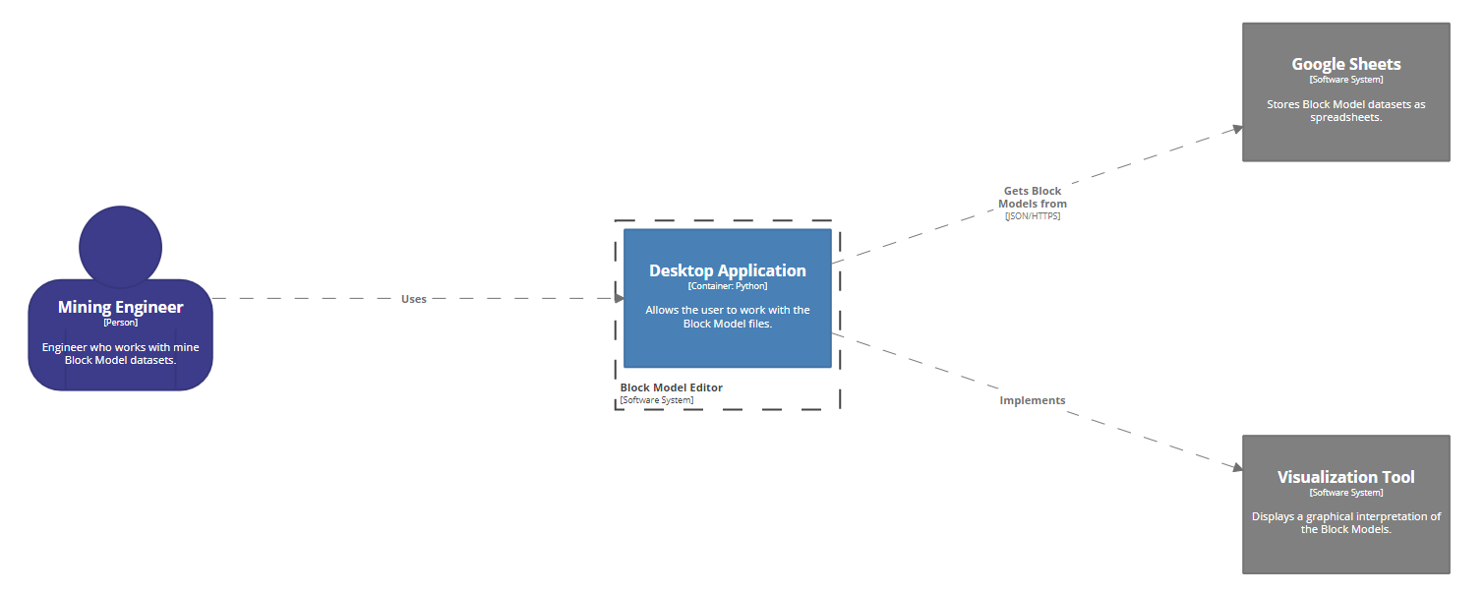
Container Diagram 1

Slide 7
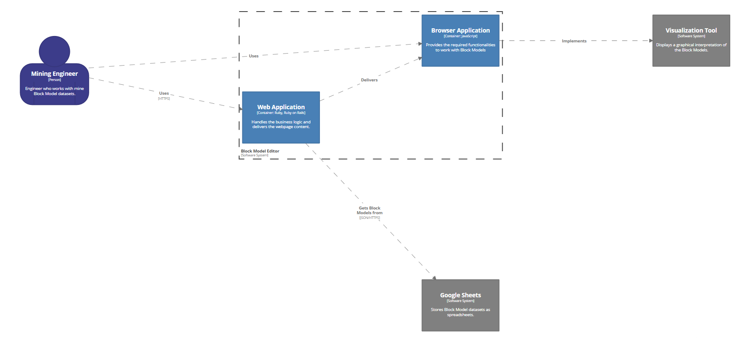
Container Diagram 2

